Slide 1
FRG Client Feedback Survey
Thursday, May 24, 2018

Slide 2
The best way for us to show our effectiveness is to let you hear the honest reactions of our clients. We do a satisfaction survey, mostly for our internal improvement every 2 years. Below are the results.

Slide 3
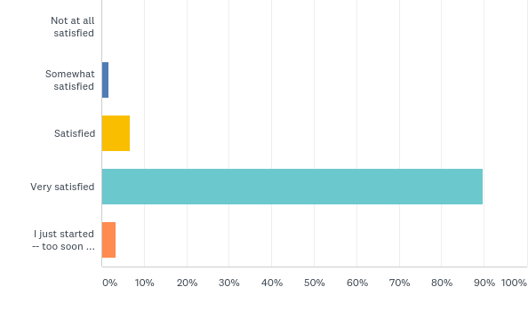
Overall, how satisfied are you with the support you've received here at FRG?
Answered: 59 Skipped: 0

Slide 4
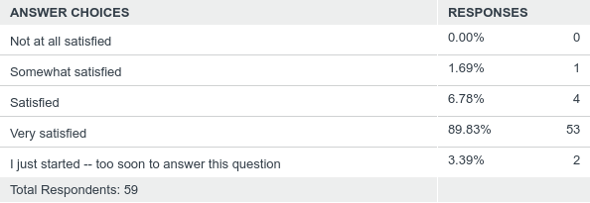
Overall, how satisfied are you with the support you've received here at FRG?
Answered: 59 Skipped: 0

Slide 5
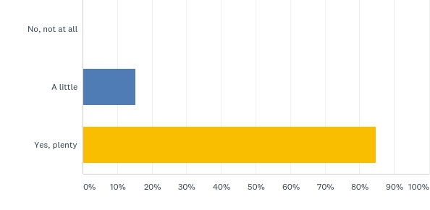
Do you feel like the work you are doing at FRG is improving your health?
Answered: 59 Skipped: 0

Slide 6
Do you feel like the work you are doing at FRG is improving your health?
Answered: 59 Skipped: 0

Slide 7
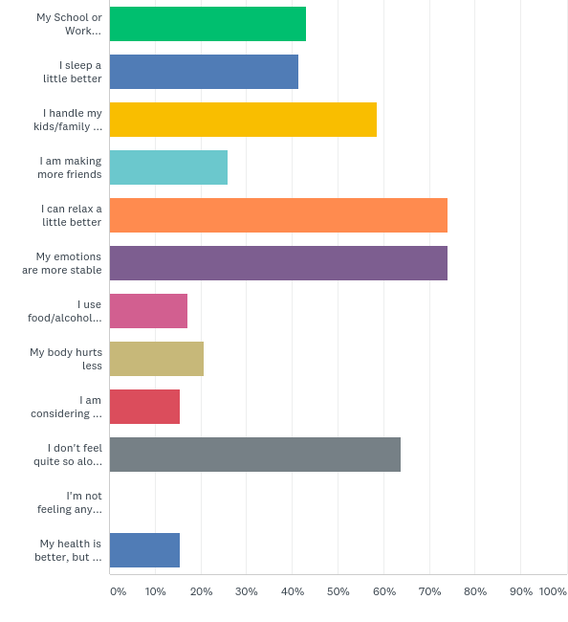
If your FRG sessions are improving your health even a little, in what ways? (check all that apply)
Answered: 58 Skipped: 1

Slide 8
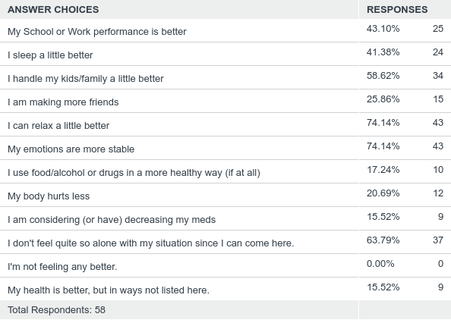
If your FRG sessions are improving your health even a little, in what ways? (check all that apply)
Answered: 58 Skipped: 1

Slide 9
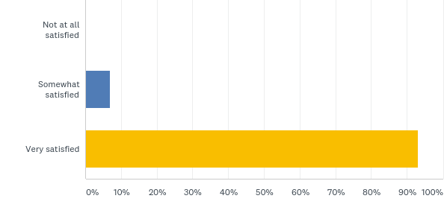
Overall, how satisfied with your therapist are you?
Answered: 58 Skipped: 1

Slide 10
Overall, how satisfied with your therapist are you?
Answered: 58 Skipped: 1

Slide 11
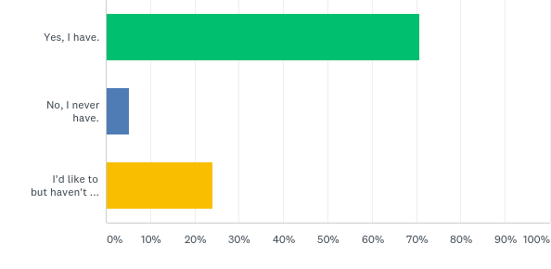
Have you ever recommended us to someone else?
Answered: 58 Skipped: 1

Slide 12
Have you ever recommended us to someone else?
Answered: 58 Skipped: 1

